Slide 1
Supply and Demand Application

Slide 2
D
______1. Buying only one instead of three or four sodas at lunch describes what concept?
a. demand b. consumerism
c. marginal utility d. diminishing marginal utility
______2. Which of the following would cause a change in the quantity demanded for a product?
a. changing consumer tastes c. decreasing the price of a product
b. increasing consumer income d. changing prices of related products
______3. How does the demand curve respond to an increase in demand?
a. the curve shifts left c. there is movement along the curve
b. the curve shifts right d. there is no change in the curve
______4. All of the following are determinants of demand elasticity EXCEPT
a. whether the purchase of the product can be delayed
b. whether there are adequate substitutes for the product
c. whether the purchase of the product requires a large portion of income
d. whether the product has utility
______5. The Law of Demand indicates which of the following situations least likely to occur
a. Strong consumer turnout at Costco for bulk discount purchases
b. Large crowds hitting the stores during a liquidation event
c. Online customers making disproportionately large purchases the day before a big sale
d. Consumers being discouraged by a price increase after the holidays
C
B
D
C

Slide 3
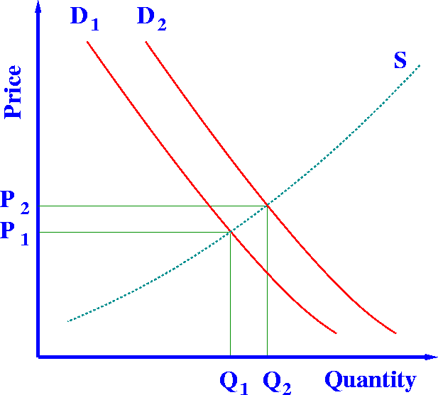
Demand and Supply Shifts
The 6 Demand Shifts
-Consumer Income
-Consumer Taste
-# of Consumers
-Expectations
-Price of Complements
-Price of Substitutes
Name the 6!
Name the 7!
The 7 Supply Shifts
-# of Sellers
-Productivity
-Technology
-Cost of Inputs
-Government Regulations
-Taxes & Subsidies
-Expectations

Slide 4
1._________________: President Trump gives a tax refund
2. _________________: Edrian buys more hats because he notices all of his friends are wearing them.
3. _________________: Crushed Red Pepper goes on sale, so people demand more pizza slices.
4. _________________: The Price of Flip-Flops rises, therefore more people buy sandals.
5. _________________: The price of cereal rises, as a result, demand for milk falls.
6. _________________: There are more people buying groceries.
7. _________________: The price of cake frosting falls, so people demand more cake mix.
8. _________________: Americans love the new Eggplant Coke
9. _________________: Prajesh is scheduled for fewer shifts.
10. _________________: The price of Frozen Yogurt drops, as a result, the demand decreases for ice cream.
Consumer Income
Consumer Tastes
Price of Complements
Price of Substitutes
Price of Complements
# of Consumers
Price of Complements
Consumer Tastes
Consumer Income
Price of Substitutes

Slide 5
NEWSPAPER HEADLINE
_________________ “Faster internet speed allows Amazon.com to do more business”
_________________ “Orange juice producers happy that price of labor for fruit pickers falls”
3. _________________ “Northern California farmers turning to Apricots”
4. _________________ “Sacramento lawmakers declare all cars to have tougher smog standards by 2022”
_________________ “Suppliers expect Apple Fanatics will pay more for iPhone 19 in December”
6 . _________________ “Starbucks offers bonus, workers work harder”
_________________“Boeing wins Federal dollars for aerospace project”
8. _________________ “Hershey Company worried because price of South American cocoa rises”
Productivity/Technology
Cost of Inputs
# of Sellers
Gov. Regulations
Expectations
Productivity
Subsidies
Cost of Inputs

Slide 6
Taxes
9. ______________________ “Oregon Legislators pass new gas tax: Oil Executives Threaten Litigation”
10. ______________________ “Workers go on strike at Jamba Juice over poor working conditions”
11 ______________________ “Mista Bale forms a new wig company in an already crowded market.”
12. ______________________ “McDonalds executives bemoan the rising
price of ketchup, Consumers to feel the impact”
13. ______________________ “Krispy Kreme engineers create a new icing machine that wastes less icing on donuts.”
14 ______________________ “Workers in the Mr. Sketch factory are promised more smell breaks if they work faster.”
15 ______________________ “New Transfat tax is announced for snack foods.”
Productivity
# of Sellers
Cost of Inputs
Technology
Productivity
Taxes

Slide 7
Elasticity: Describe why each is what it is…
$
$
Inelastic
Close to
Perfectly Inelastic
Elastic
Elastic
Unitary (Unit)
Asthma Inhaler
Disney Themed Bird Bath
Customized T-Shirts
Tank of Gasoline
70” Flat Screen Television
Q
Q

Slide 8
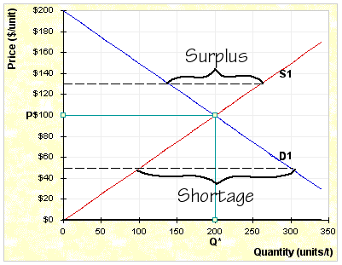
$140 =
$100 =
$50 =
$40 =
$170 =
$120 =
Surplus of ~160
Equilibrium!
Shortage of ~200
Shortage of ~240
Surplus of ~280
Surplus of ~80

Slide 9
Related Shifts
Assume that a heavy frost destroys half of the world’s rice crop and that people use more butter for corn than they do for rice. What would happen to the markets (graphs) below if this were to happen?
1. Rice
2. Corn
3. Butter
4. Corn Harvesters (farm machinery)
# of Sellers/Productivity
Price of Substitutes
Price of Complements
Expectations

Slide 10
Related Shifts
Michael Jordan comes out with the Jordan XXIX Nike shoes which are advertised heavily and attract great attention from shoe buyers. Customers rush to the store to buy up the Jordans.
1. Nike Shoes
2. Adidas Shoes
3. Rubber
4. Matching Jordan Apparel
Consumer Tastes
Price of Substitutes
Expectations
Price of Complements

Slide 11
Related Shifts
Connecticut ships large amounts of apples to all parts of the U.S. by rail. What would happen to the markets (graphs) below if a hurricane destroyed the apples before they are picked in Connecticut?
1. Apples
2. Land devoted to apple orchards in the state of Washington
3. Pears
4. Apple Pies
# of Sellers/Productivity
Expectations
Price of Complements
Cost of Inputs

Slide 12
Following Price
Product: Footballs
Fall comes around and football fever is in the air. Consumers watch a ton of football and many are now interested in buying a football of their own. Unfortunately for producers trying to capitalize on this new market, a shortage of leather causes a huge upswing in price. Just afterwards, Adidas decides to drastically lower the price of their soccer balls leaving consumers with a cheaper option for sporting goods and fewer footballs are purchased that when the Fall started. Fortunately for producers, the government removes a regulation that caused leather manufacturing to take longer than it once had, vastly speeding up production. This is combined with a new advertising campaign that features many unpopular celebrities with footballs that backfires and discourages people to buy footballs. As winter rolls around, consumers find new interests in hockey gear and football sales plummet again.

Slide 13
Product: Footballs
$
E3
E2
E4
E1
E5
E6
S2
S1
S3
D3
D1
D2
D4
#

Slide 14

Why do bars charge patrons for water but give them peanuts for free?

Slide 15
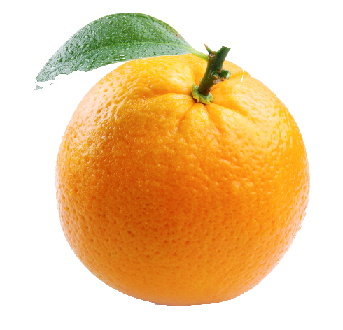

Florida Citrus Shifts
Product (Ex. Oranges)
One/Two sentence description of where you see this shift in the article
Variable (one of the 6 or 7 shift types)
Document 8 Total Shifts in the Article for ANY products/services that you see mentioned. Products can be used more than once as you see multiple movements in S or D.

Slide 16
Related Shifts
Flooding at the Doritos Plant has caused a massive loss of product and there is projected to be a three month time frame to get back to normal production.
1. Doritos chips
2. Taco Bell’s Doritos Locos Tacos
3. Frito Lay Potato Chips
4. Standard corn Tortilla shells

