Slide 1
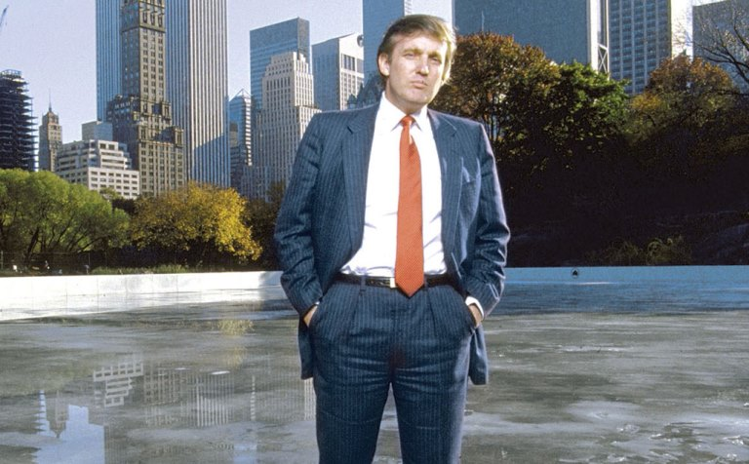
Wollman Ice Rink: Why was Donald Trump so successful when public efforts were so spectacularly unsuccessful?

